Slide 1
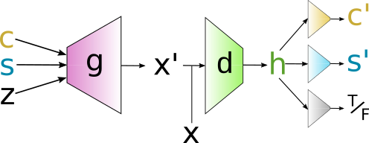
InfoGAN for tumor molecular subtyping
Early success in precision medicine used ML to learn cancer subtypes from transcriptome expression levels to personalize breast cancer treatment options.
Current work using public curated microarray data from breast cancer patients improves prediction of relapse free survival over PAM50 subtyping procedure used by Progenta gene signature assay.
Inputs/outputs descriptions:
C - categorical variable, one-hot vector (for learned sub-types)
S - continuous variable, sampled from normal distribution
Z - continuous variable, sampled from normal distribution
X - gene expression vectors
X’ - gene expression vectors generated from <C, S, Z> (and g)
h - hidden representation generated by discriminator network (d)
C’ - reconstructed C
S’ - reconstructed S
T/F - discriminator’s output for adversarial loss
Link to research repository:
https://github.com/singnet/cancer/tree/master/ml

